Slide 1
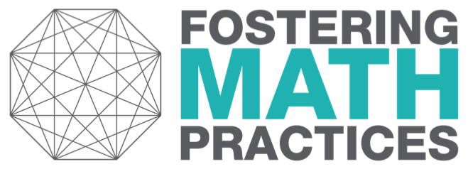
Connecting Representations
An Instructional Routine to Develop ALL Students’ Structural Thinking
www.fosteringmathpractices.com

Slide 2
Connecting Representations
WHAT: Match written statements to equations by chunking and connecting to math you know.
WHY: To “think like mathematicians”, to use mathematical structure to match two different representations.

Slide 3
Connecting Representations
Think
Make connections
Share & study connections
Create representation
Reflect on learning

Slide 4
Think
Ask yourself…
What part of the written statement will help me connect to a chunk of the equation?
What about the equation will help me connect to the written statement?

Slide 5
Make Connections
“I saw… so I connected...”
“... connects to ... because...”

Slide 6
Share & Study Connections
We noticed… so we ...
We knew... so we...
They noticed… so they ...
They knew... so they...

Slide 7
Create a Representation
Think
Ask yourself…
“What do you notice about this equation?”
“How can you chunk this equation into pieces you can describe?”

Slide 8
Create a Representation
Pair
Share your interpretations of the equation.
Together create a matching written statement.

Slide 9
Create a Representation
Share
They noticed… so they…
When they saw…it made them think of… so they…

Slide 10
Meta-Reflection
When interpreting an equations / written statements, I learned to pay attention to…
When connecting representations, I learned to ask myself…
A new mathematical connection I made is …

